Slide 1
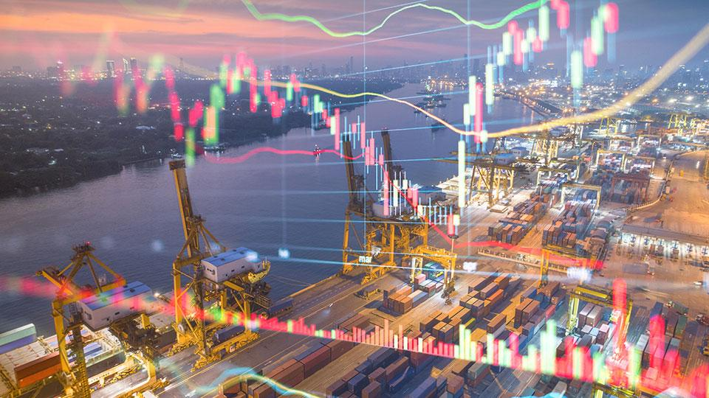
Team: Coding_Nahi_Aati
Our mission is to provide more accuracy in analysis and price prediction
thereby easing decision-making for investors.

Slide 2
Forecasting Natural Gas International Prices using advanced Time-Series Techniques
Team Name: Coding_Nahi_Aati
Team Leader Name: Shivam Tyagi
Institute Code (AISHE): U - 1056
Institute Name: Netaji Subhas University of Technology
Theme Name: Heritage & Culture

Slide 3
Problem
It is required to forecast NATURAL GAS PRICE in international market for the period 2021 to 2026. The historical data is to be extracted programmatically from public websites and models need to be built upon the data.
The trend may be analyzed vis-á-vis similar commodities like CRUDE OIL, COAL, etc. It is required to develop at least 3 independent advanced forecasting models using time-series analysis like ARIMA, EXPONENTIAL SMOOTHING and NEURAL NETWORKS (LSTM, etc.).

Slide 4
Solution
Proposition
Long term forecasting
Lowering market uncertainty
Past trend analysis
Rare events detection
Value to user
More accuracy in analysis and price prediction
Ease in decision making for investors
Knowing updates through budget friendly subscription

Slide 5
Market Size
Size of market-
All of the clients in natural gas commodity business
Sales and distribution
Total available market

Slide 6
Market Validation
Development time
Notes:
Goto market- Timeline

Slide 7
Product
Architecture ->
Adjacent markets
Metrics
Saleability
Channels

Slide 8
Business Model
Opportunities
As a service,Product etc.
Sources of revenue
The software/service can be sold on a subscription model to various interested players.
This will give an edge to corporations and companies to predict prices and make less risk decisions. 300$ per year with support and updates.
Intended customer base
Hedge funds
Investors
Economists
National strategists
Airlines (Fuel hedging)

Slide 9
Competition
Defensibility
Niche

Slide 10
Financial model and projections
Investment to develop-
Material and manpower
Assumptions
Return on Investment

Slide 11
Competitive advantages
Partnerships
Strengths of technology/Team (USPs)

Slide 12
Assumptions and risks
SWOT /PESTEL ANALYSIS
CONCERNS and RESPONSES
Risks and precautions

Slide 13
SWOT Analysis Infographics
SWOT

Slide 14
Q&A

Slide 15
Summary
Elevator pitch

Slide 16
APPENDIX/BACKUP

